Slide 1
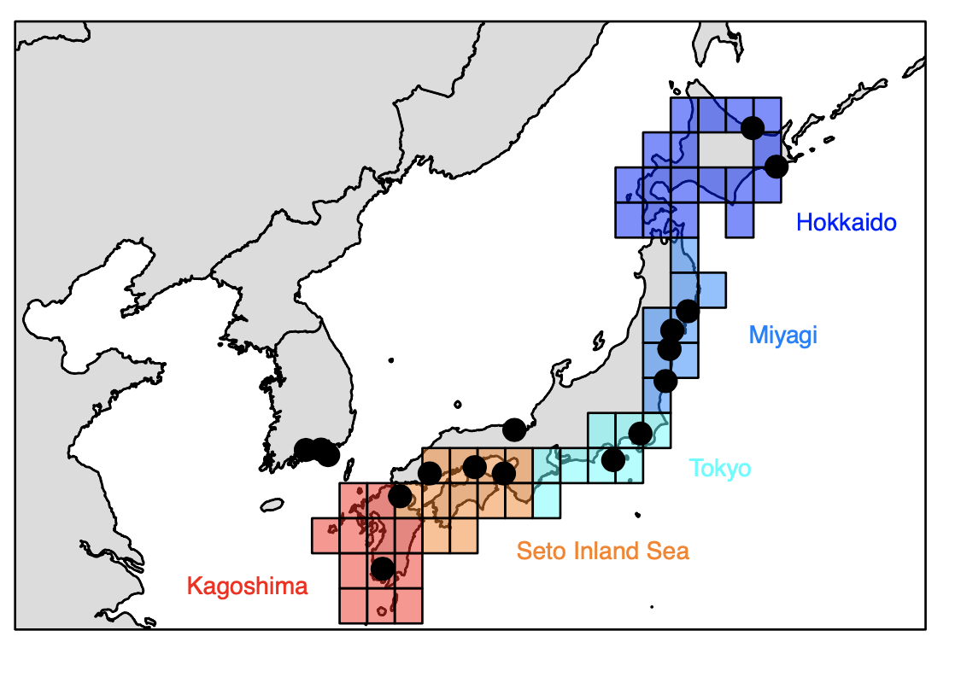
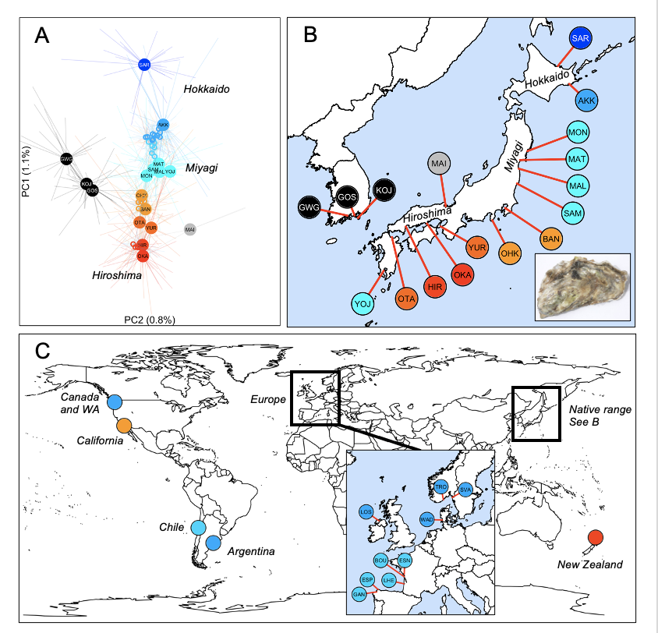
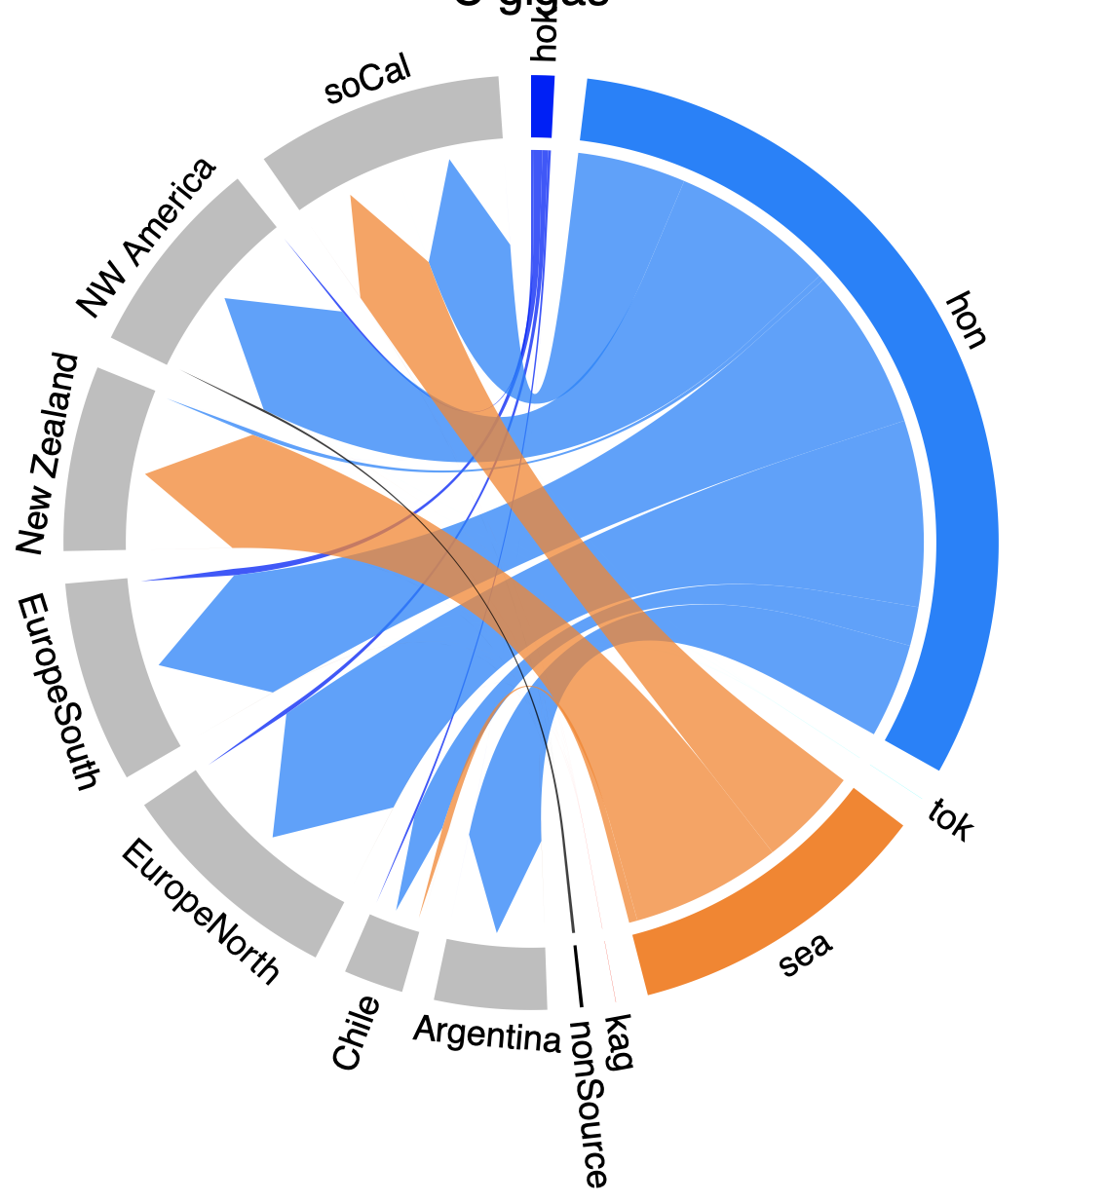
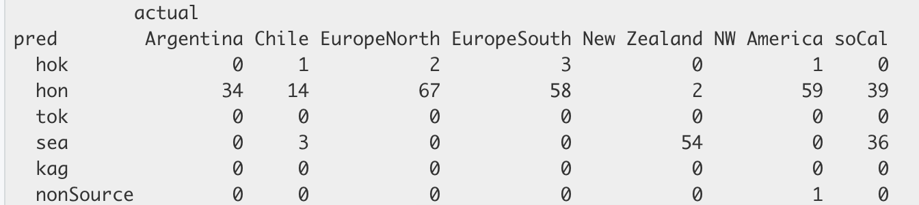
Crassostrea gigas
SNP data
Original data
ML output = cross validation accuracy 69.9%

Slide 2
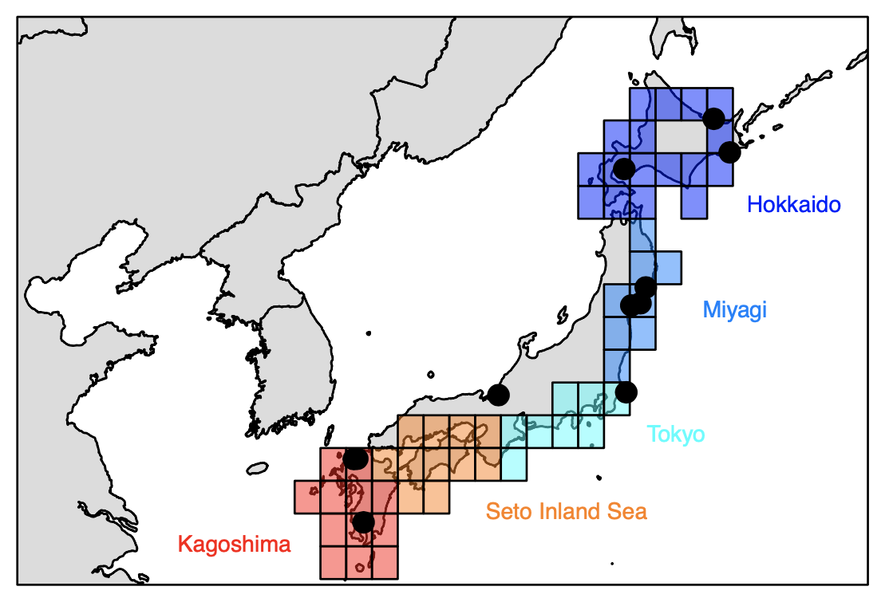
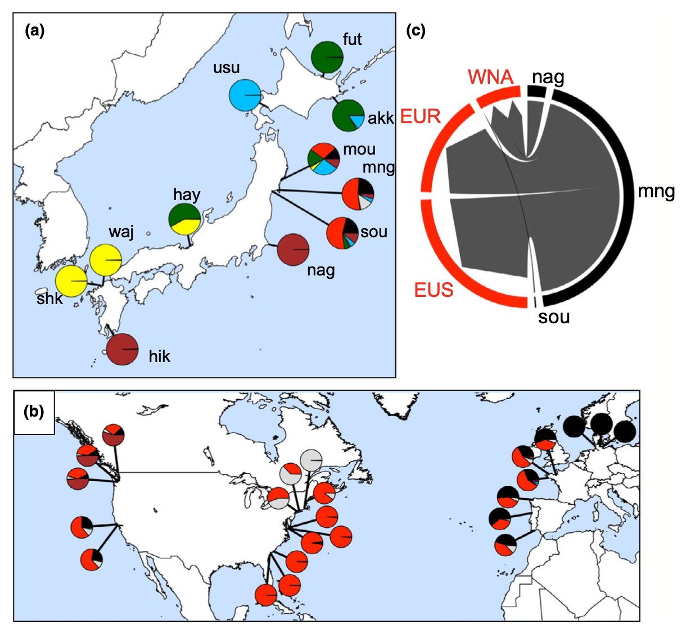
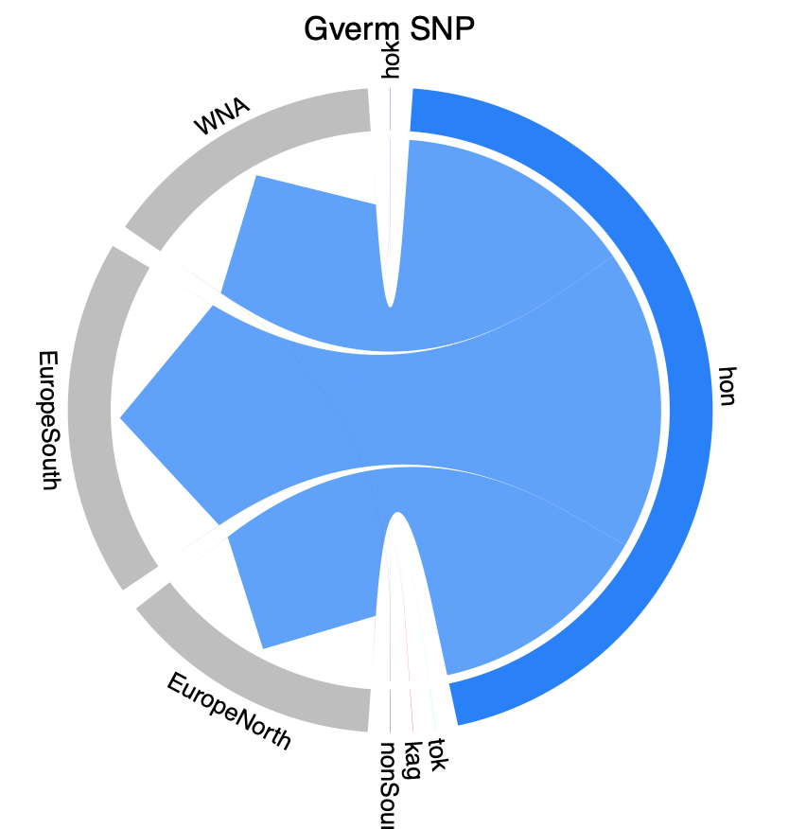
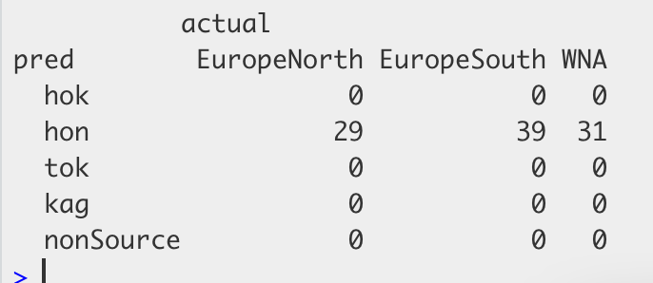
Original data – Flanagan et al 2021
Gracilaria vermiculophylla
SNP data
ML output = cross validation accuracy 100.0%

Slide 3
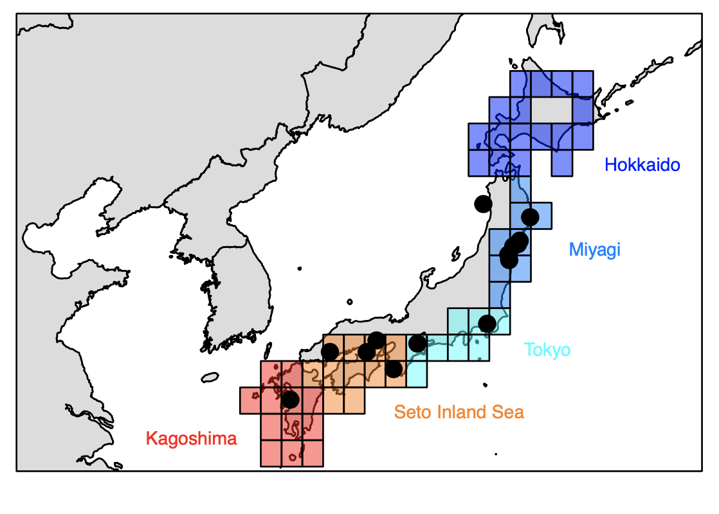
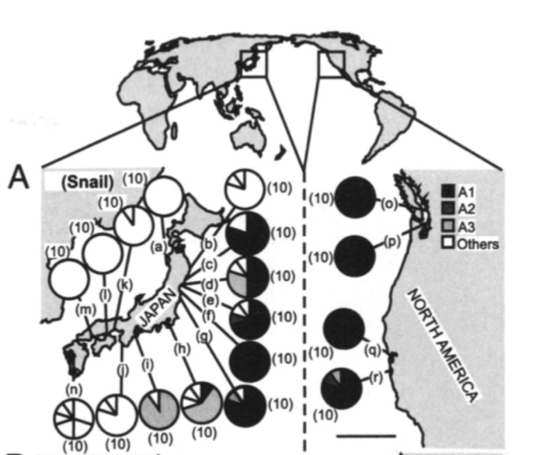
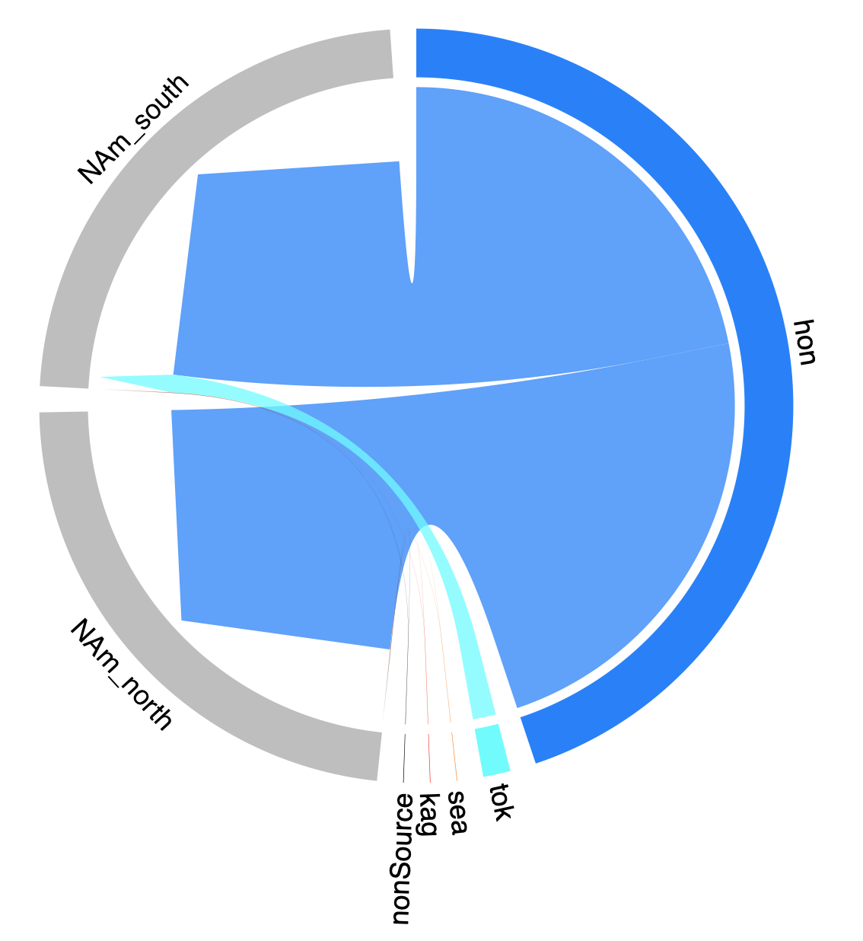
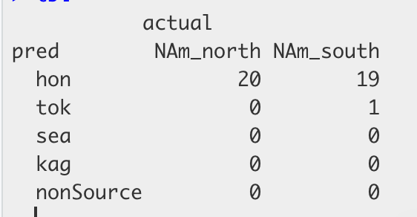
Original data – Miura et al 2006 PNAS
Batillaria attramentaria
mtDNA data
ML output = cross validation accuracy 85.3%

Slide 4
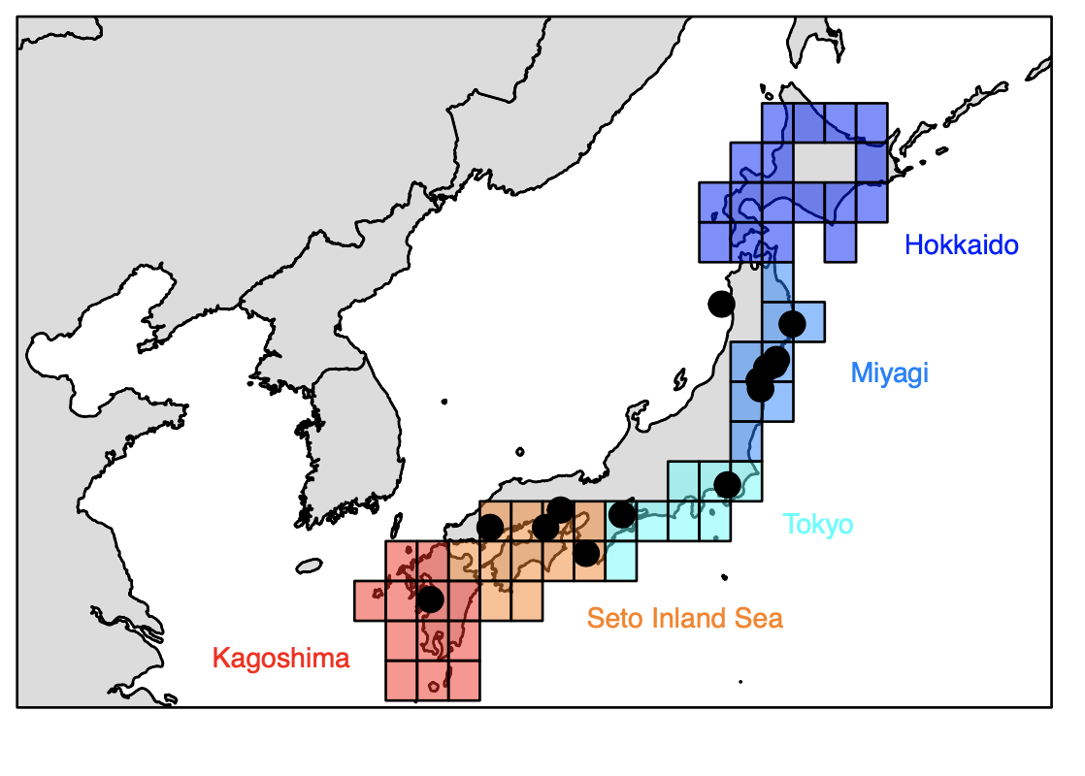
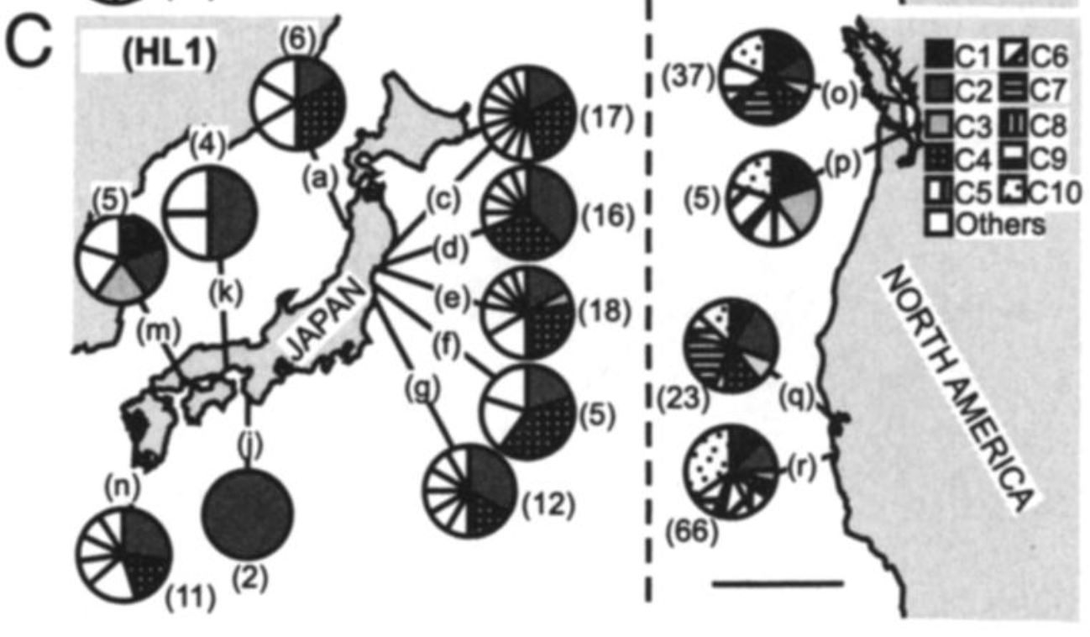
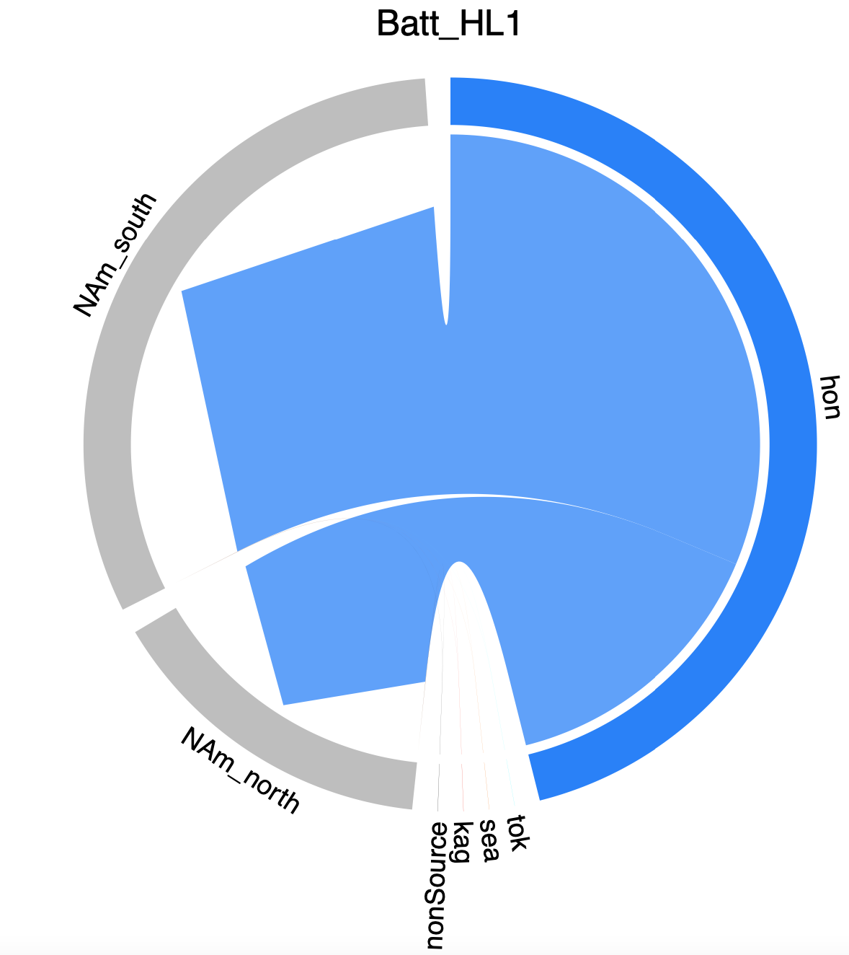
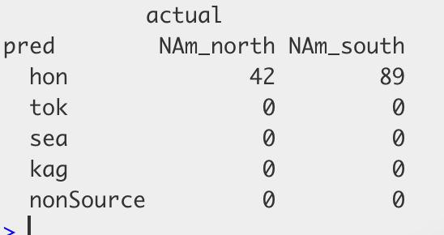
Batillaria attramentaria trematode HL1
mtDNA data
Original data – Miura et al 2006 PNAS
ML output = cross validation accuracy 68.0%

Slide 5
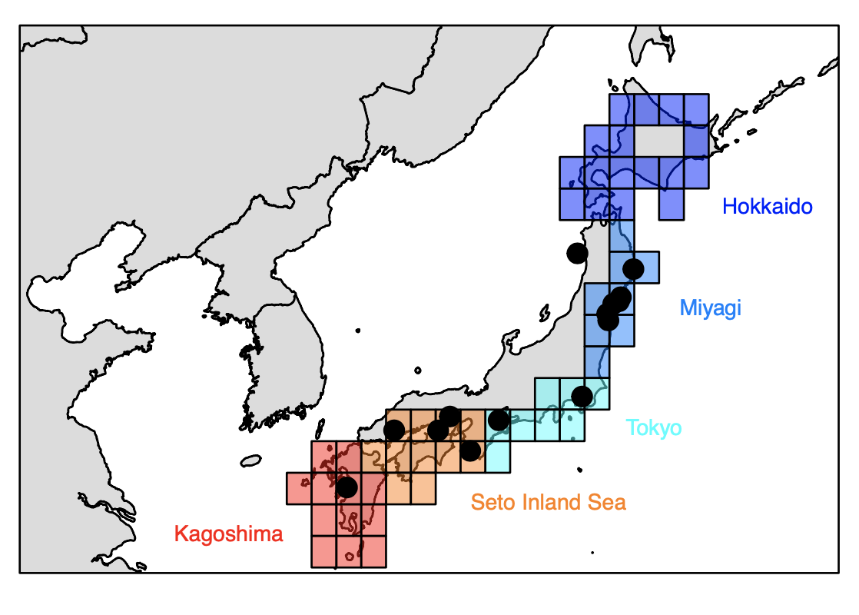
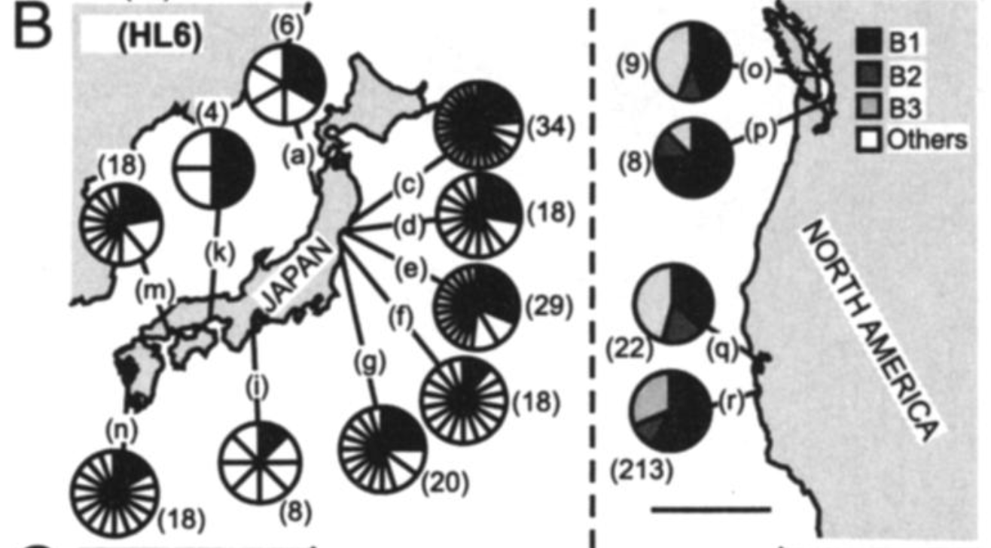
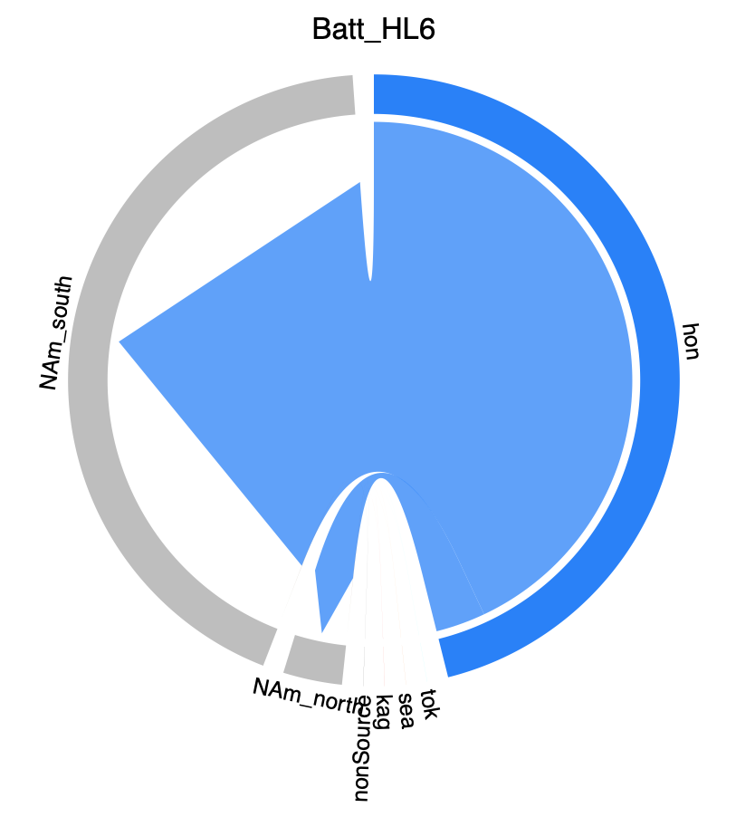
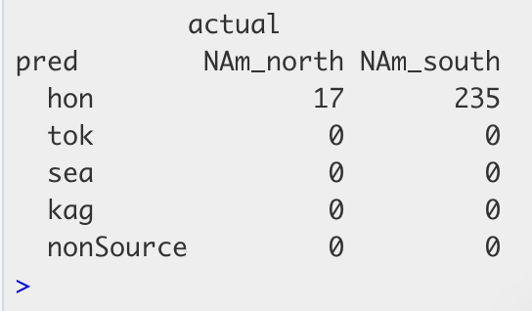
Batillaria attramentaria trematode HL6
mtDNA data
Original data – Miura et al 2006 PNAS
ML output = cross validation accuracy 67.5%

Slide 6
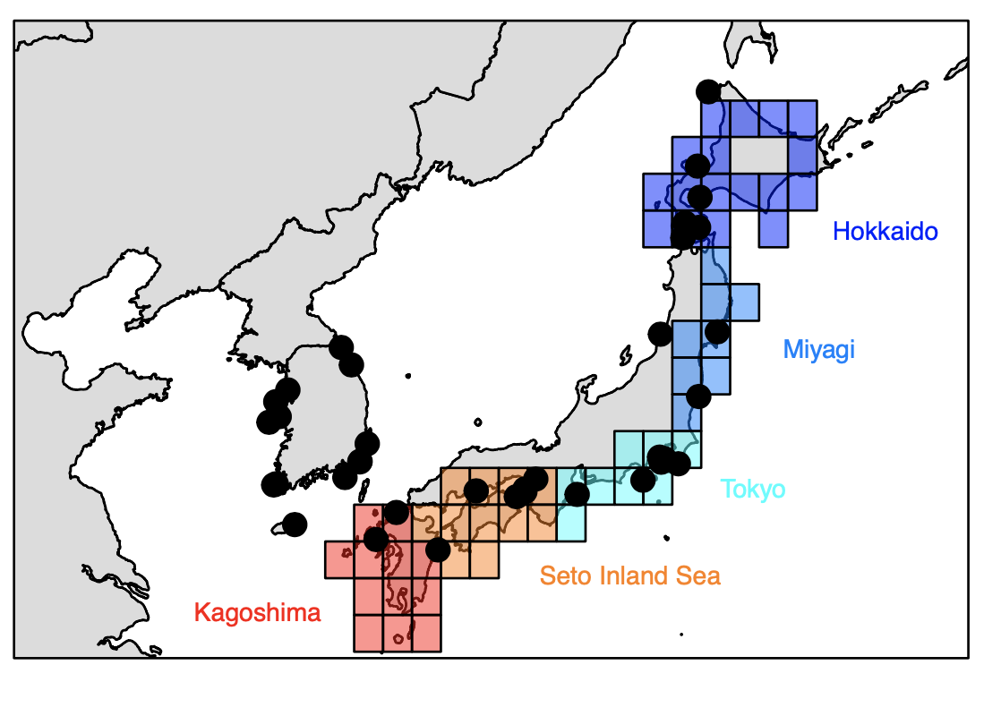
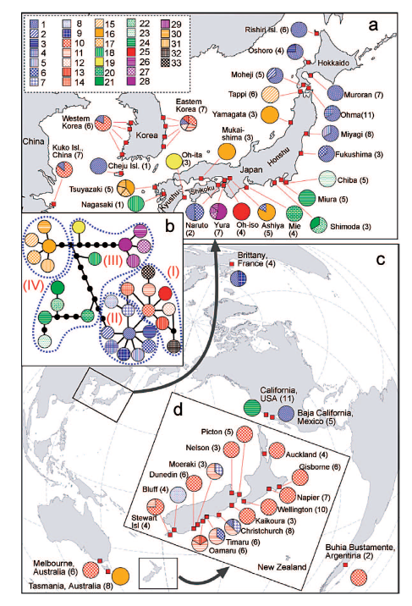
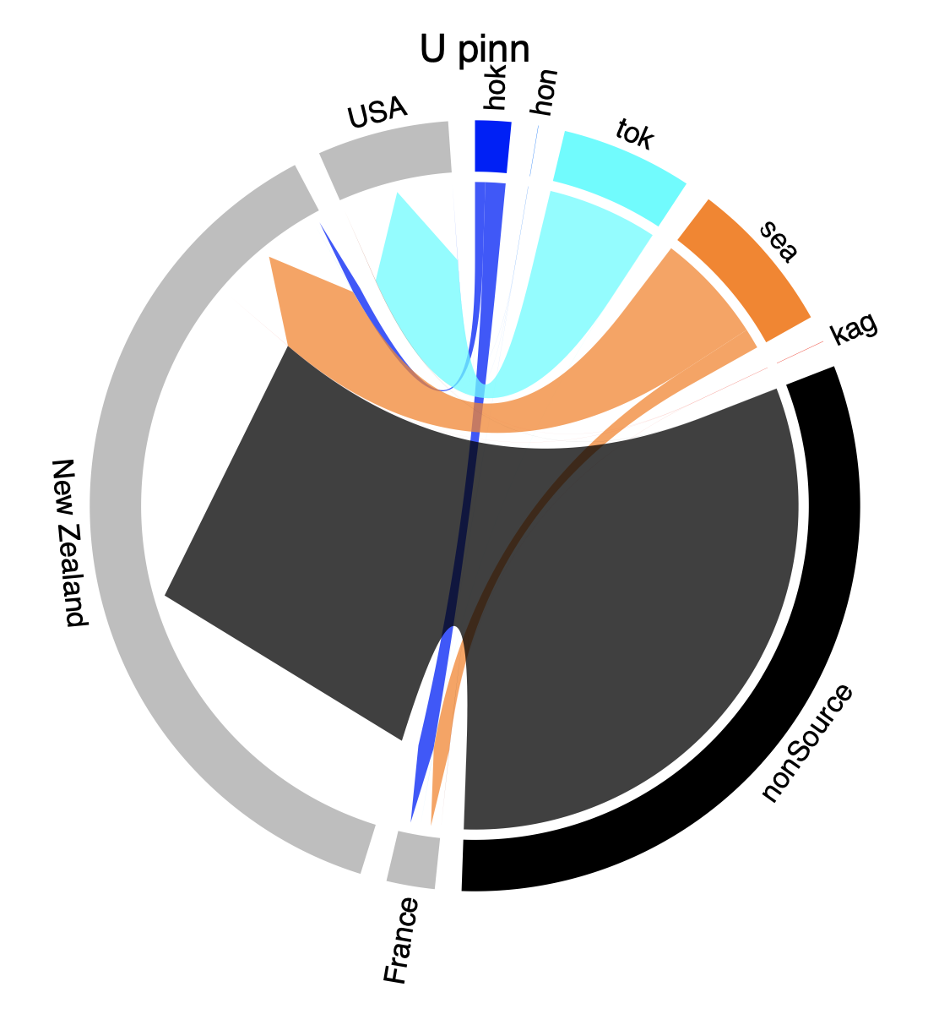
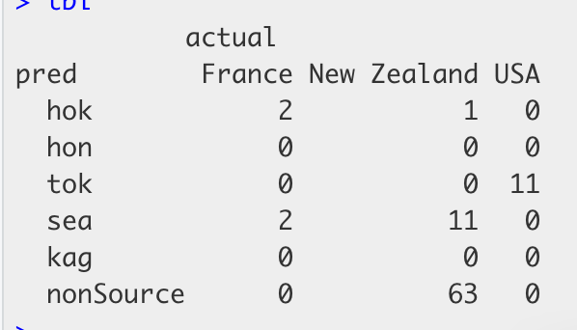
Original data – Uwai et al 2006
Undaria pinnitifida
mtDNA data
ML output = cross validation accuracy 76.4%

Slide 7
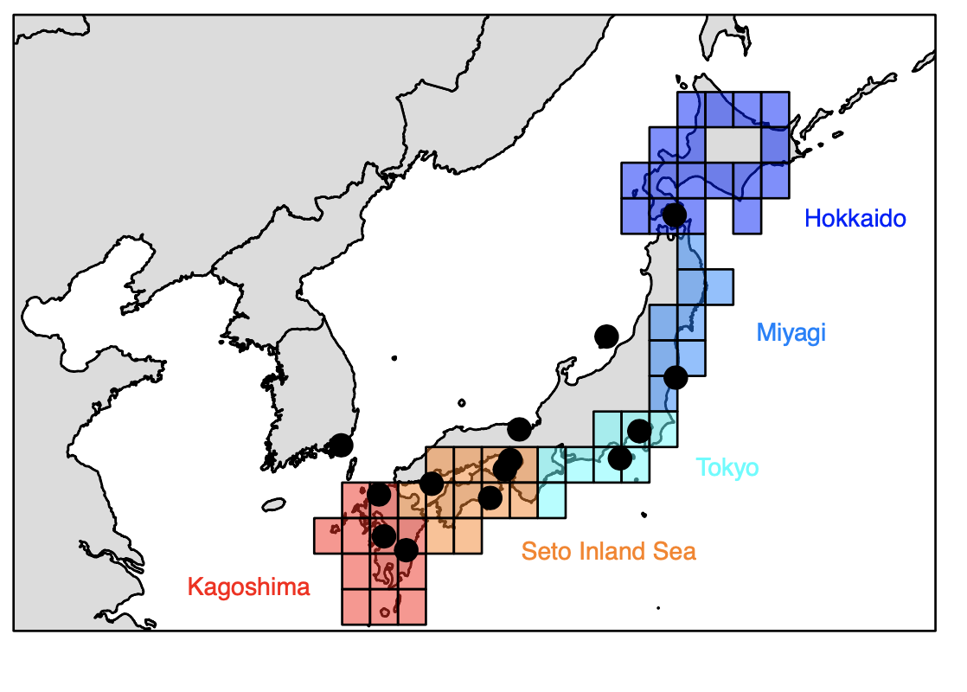
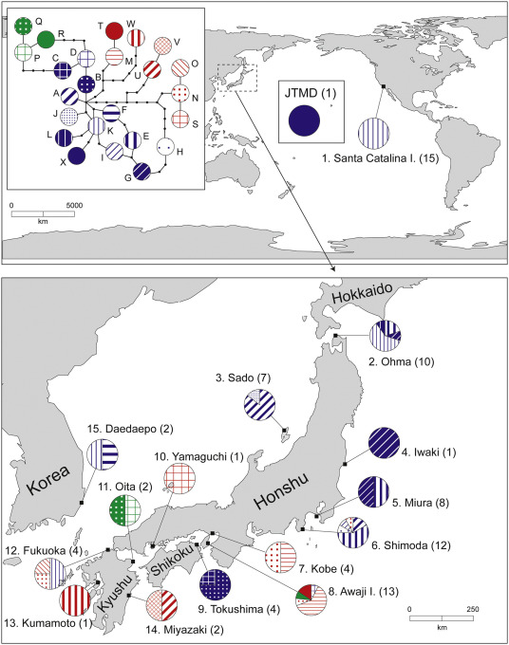
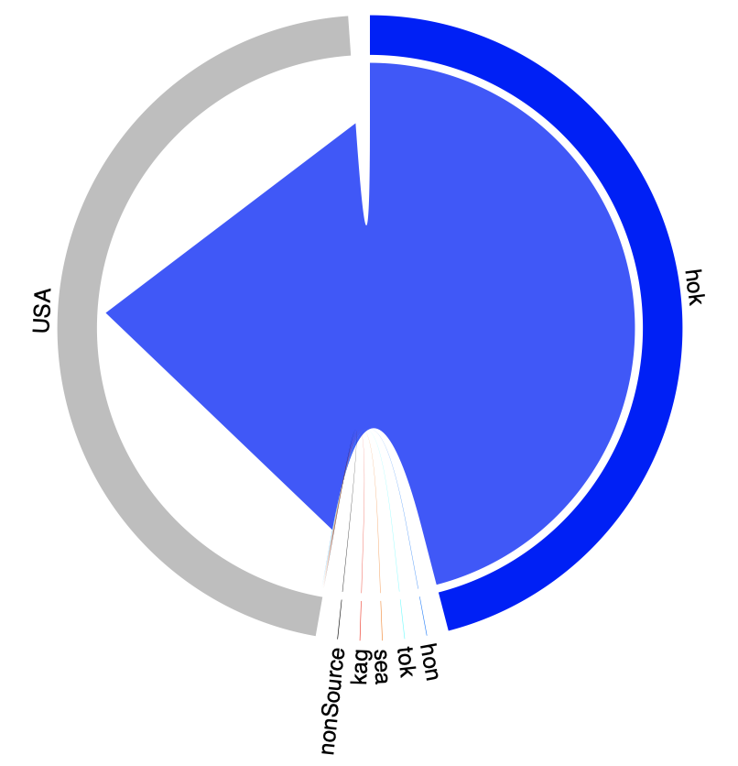
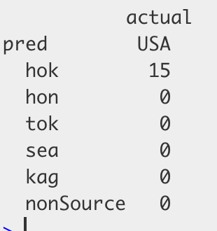
Original data – Hanyuda et al. 2018
Mutimo cylindricus
mtDNA data
ML output = cross validation accuracy 72.7%

Slide 8
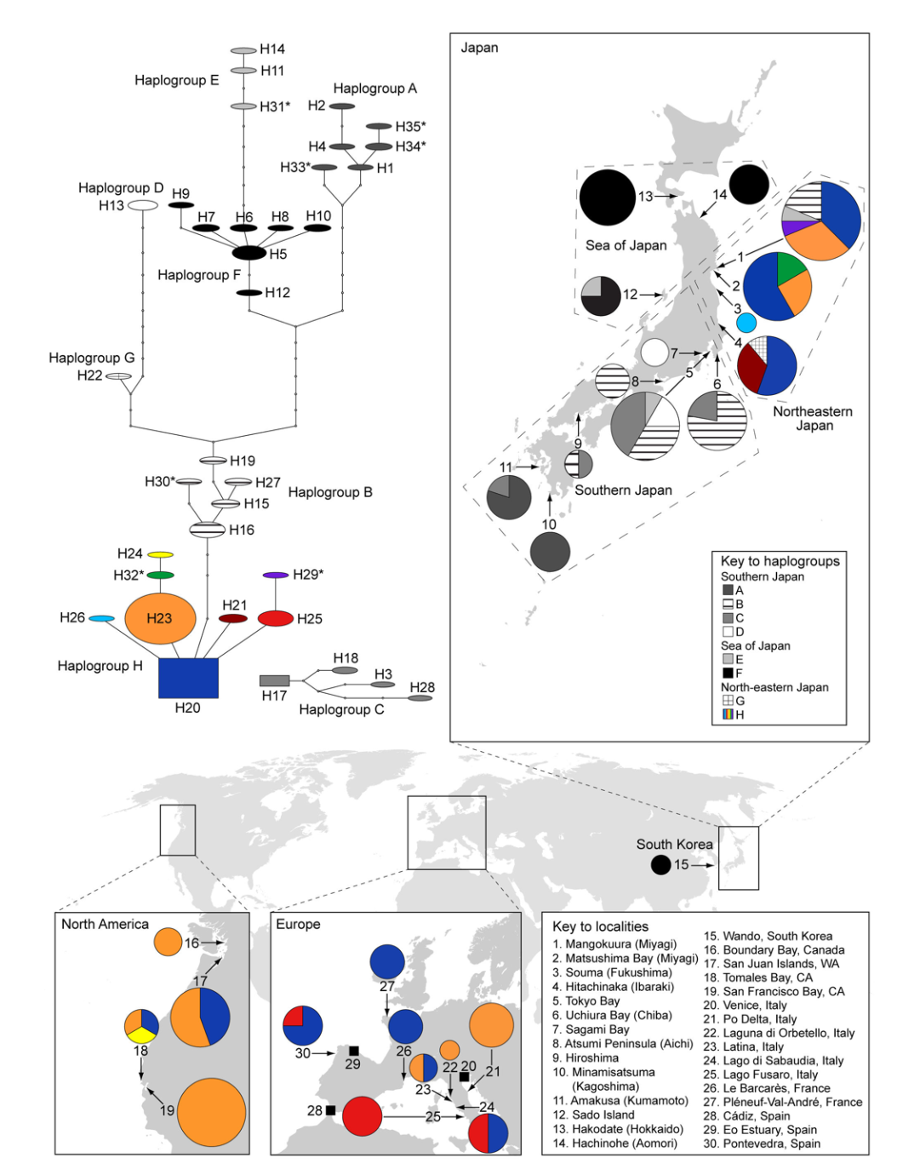
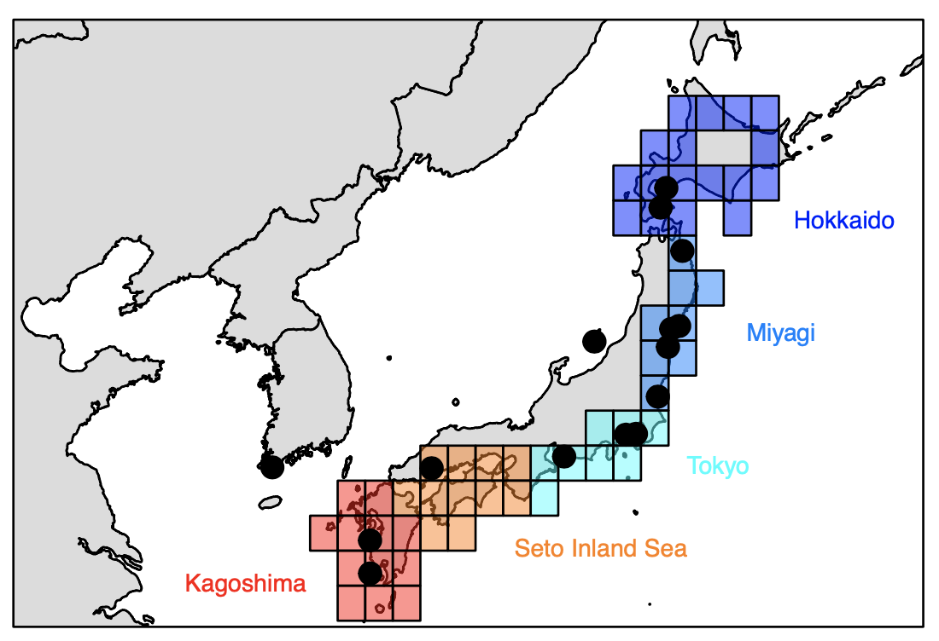
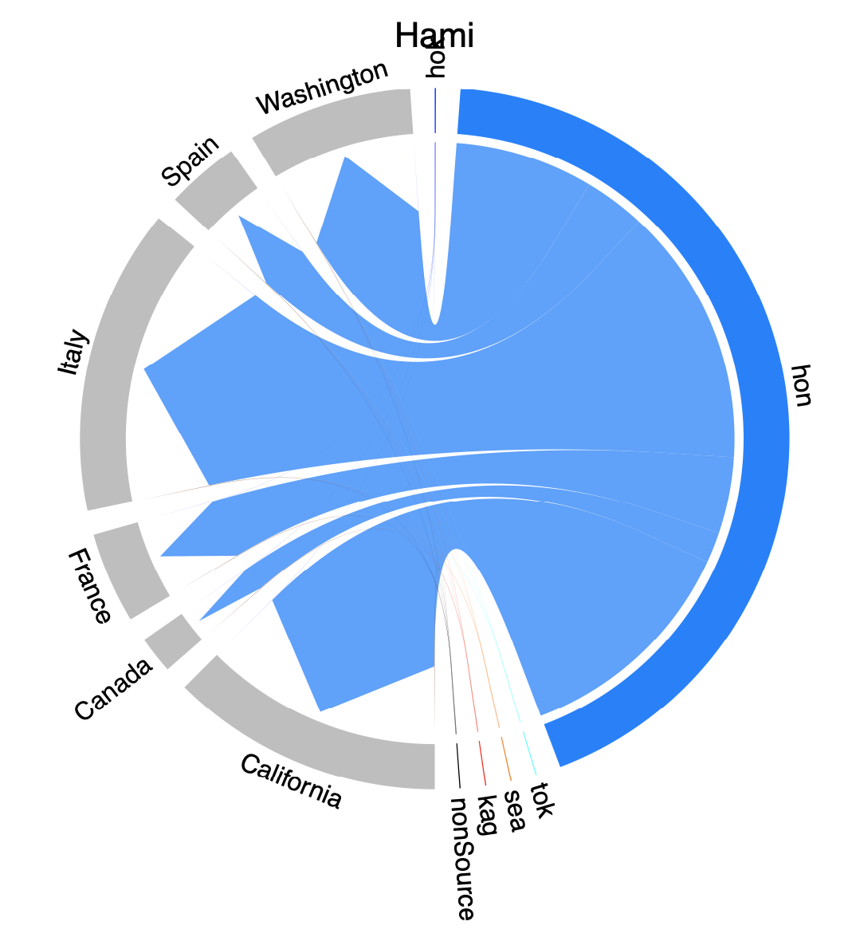
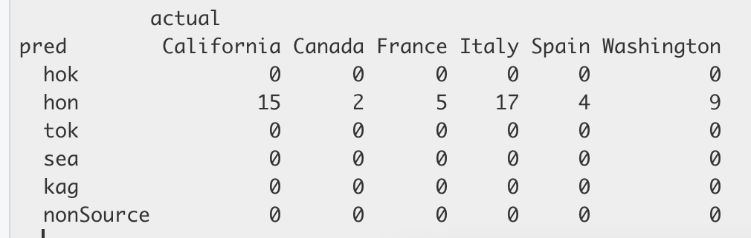
Original data – Hansen et al. 2013 PLOSONE
Haminoea japonica
mtDNA data

Slide 9
Original data – Uwai et al 2006
Undaria pinnitifida
mtDNA data
ML output = cross validation accuracy 76.4%

Slide 10
OTHER

Slide 11
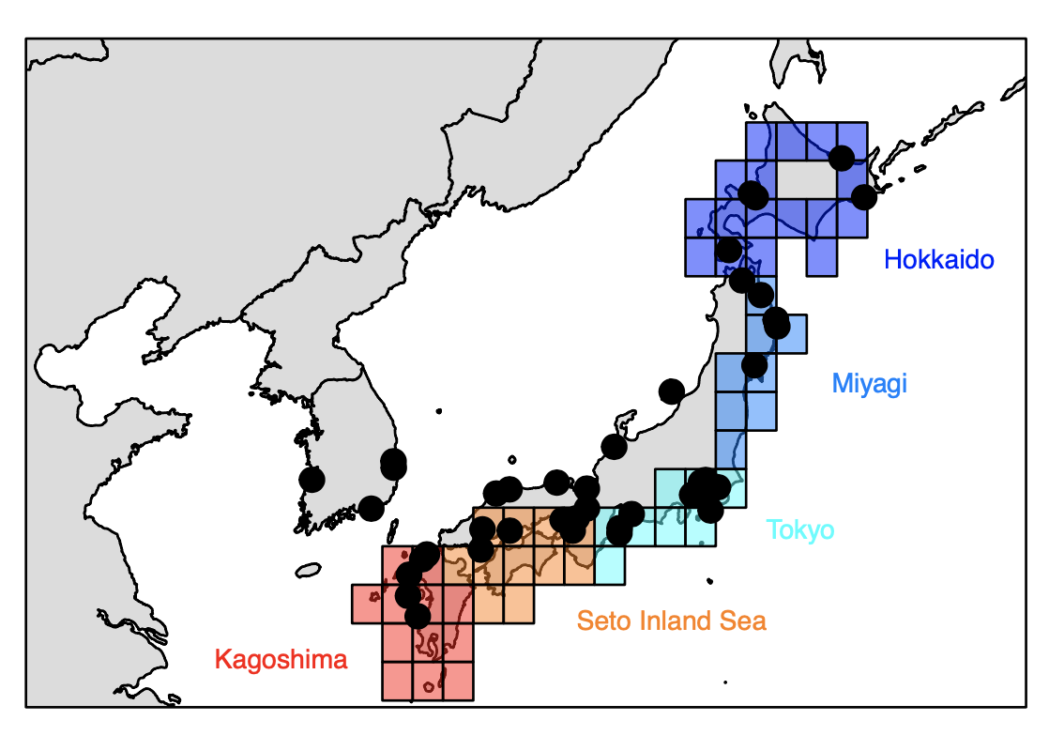
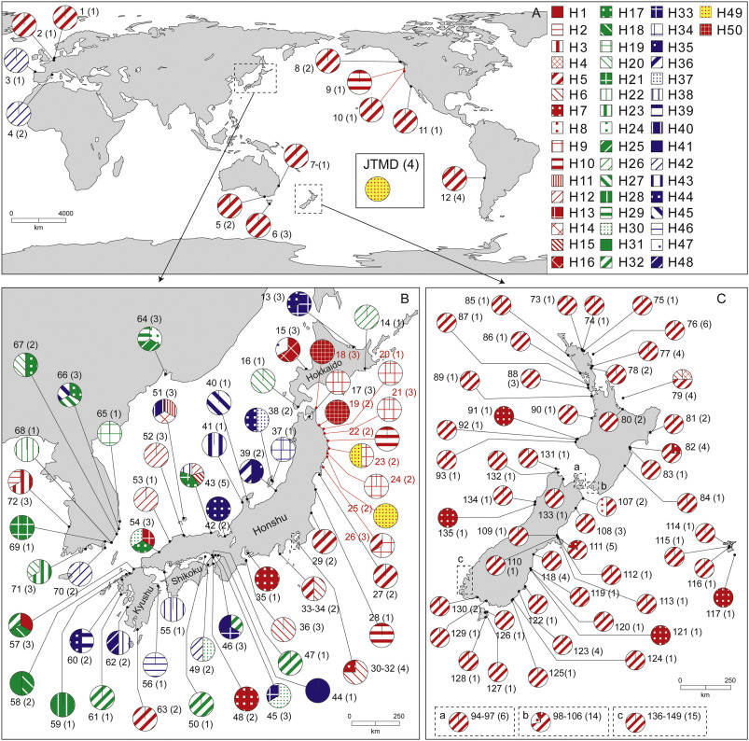
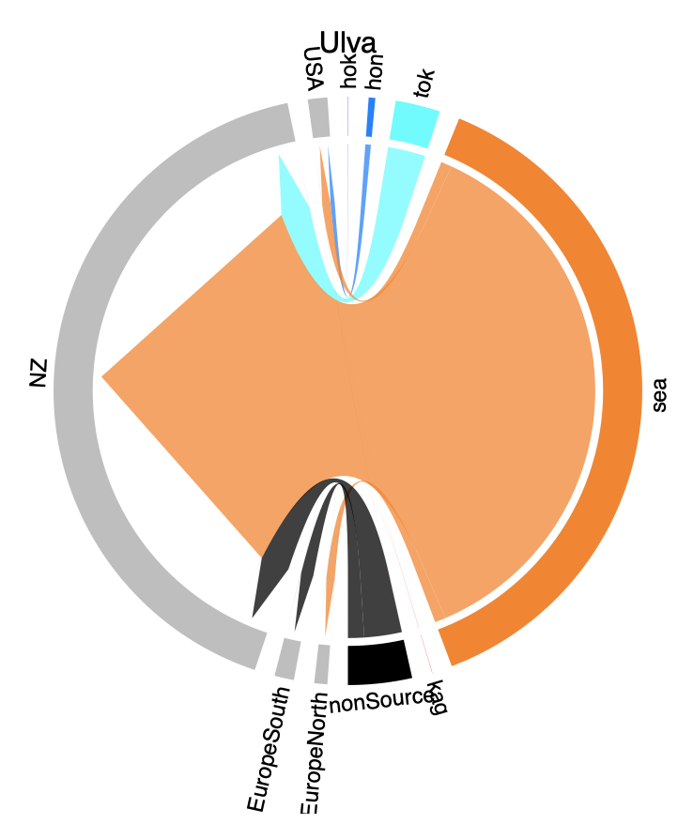
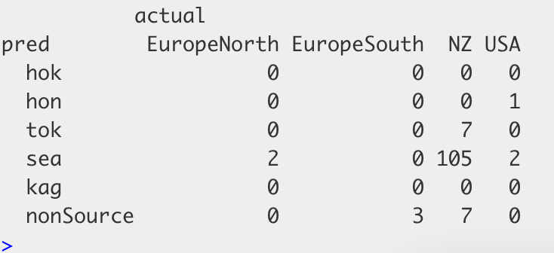
Original data – Hanyuda et al. 2018
Ulva pertusa
Chloroplast and mtDNA data
ML output = cross validation accuracy 48.4%➔ LOW. this may explain why NZ in data and ML differ.

Slide 12
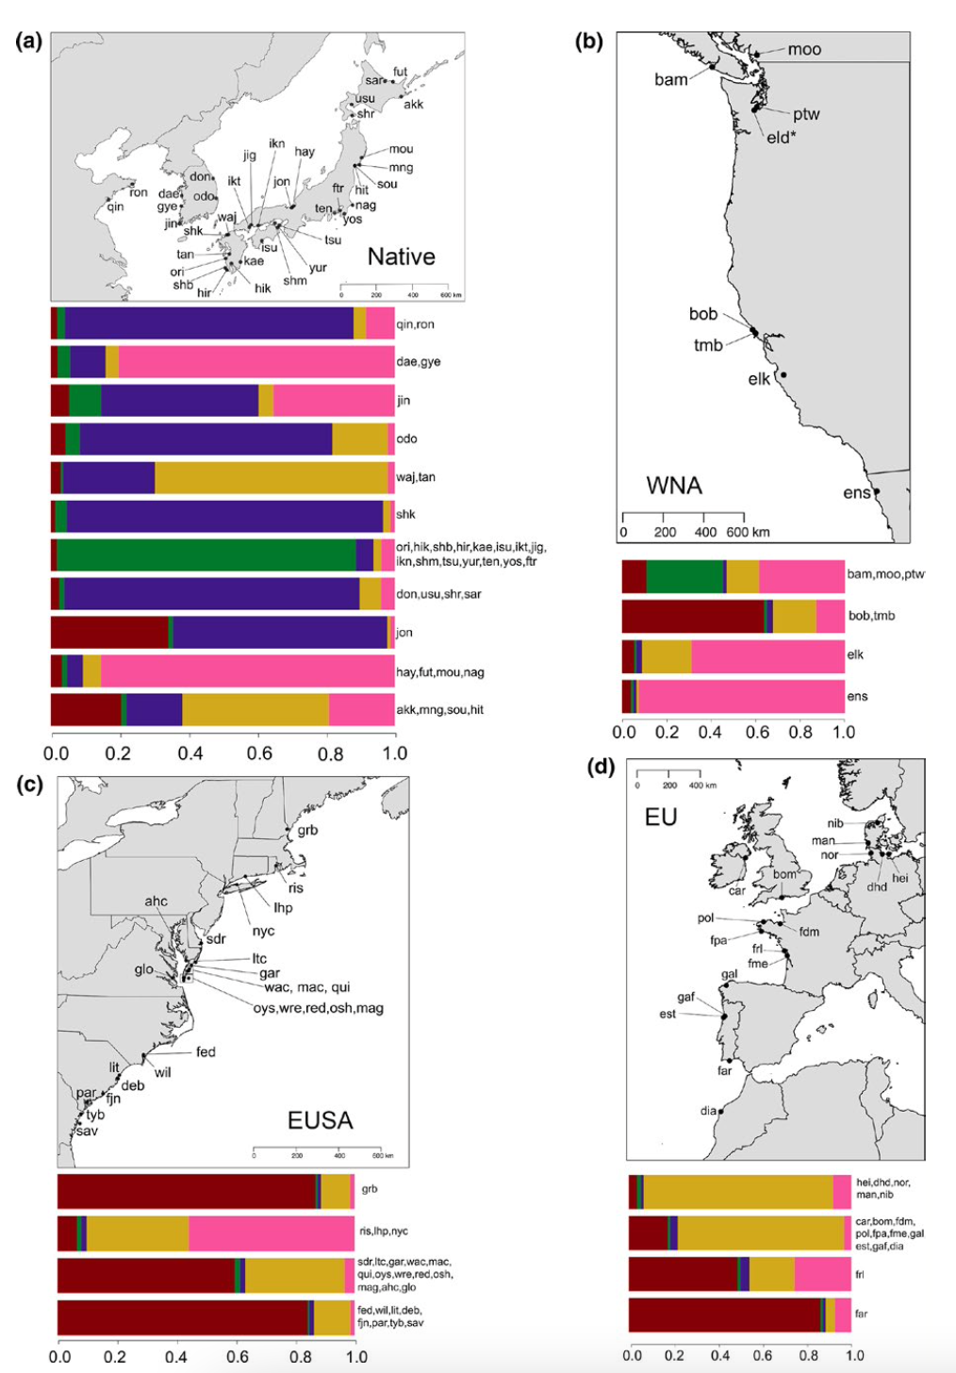
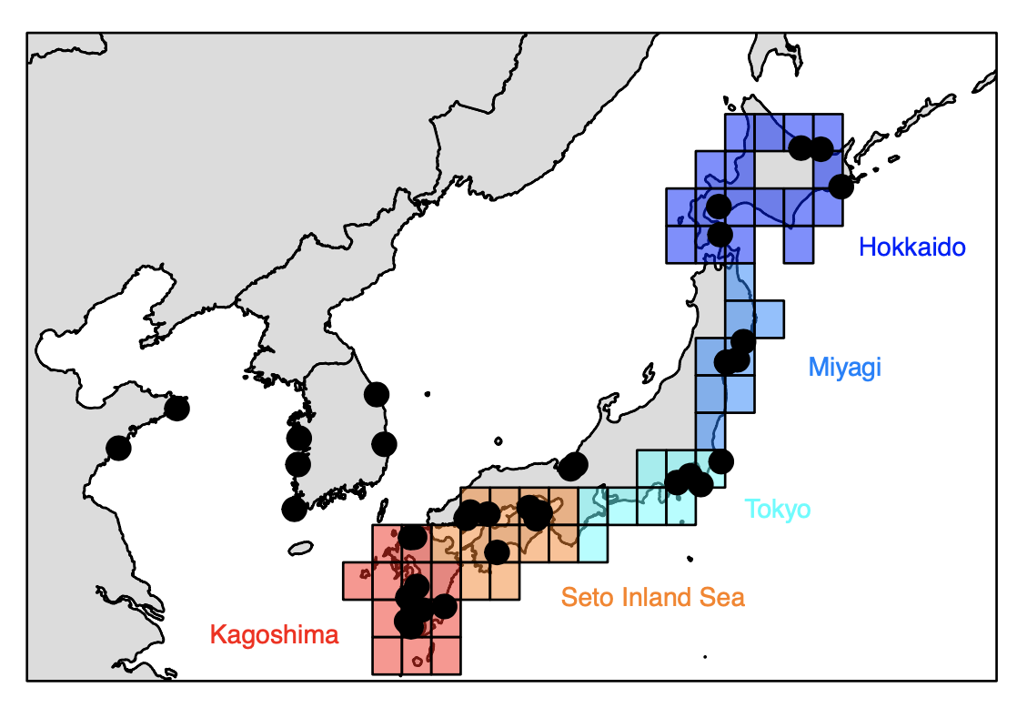
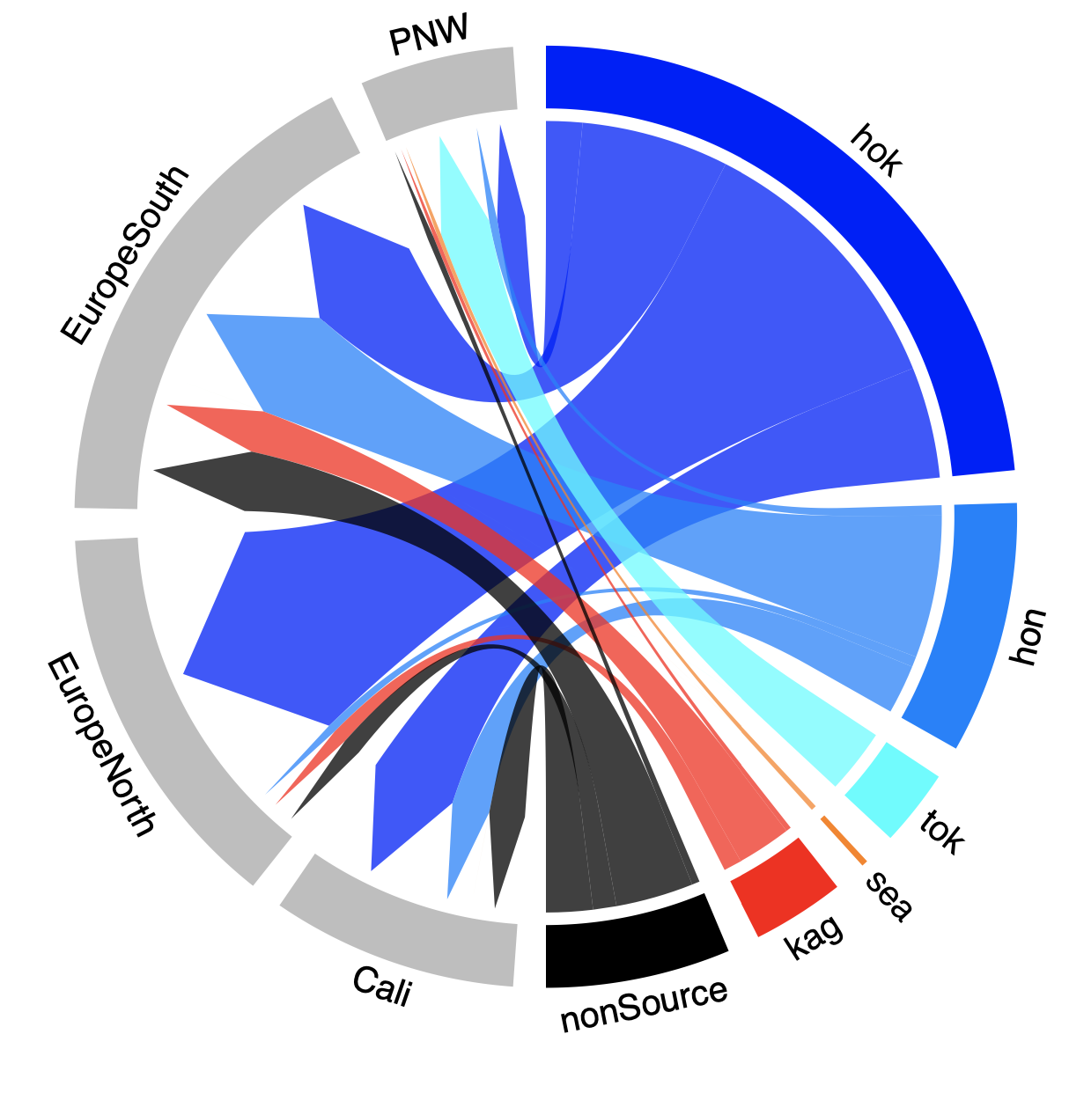
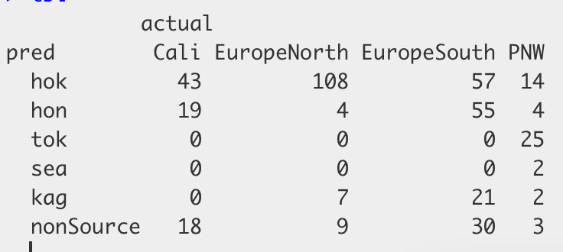
Original data – Krueger-Hadfield et al 2017
Gracilaria vermiculophylla
Usat data
ML output = cross validation accuracy 93.0%

Slide 13
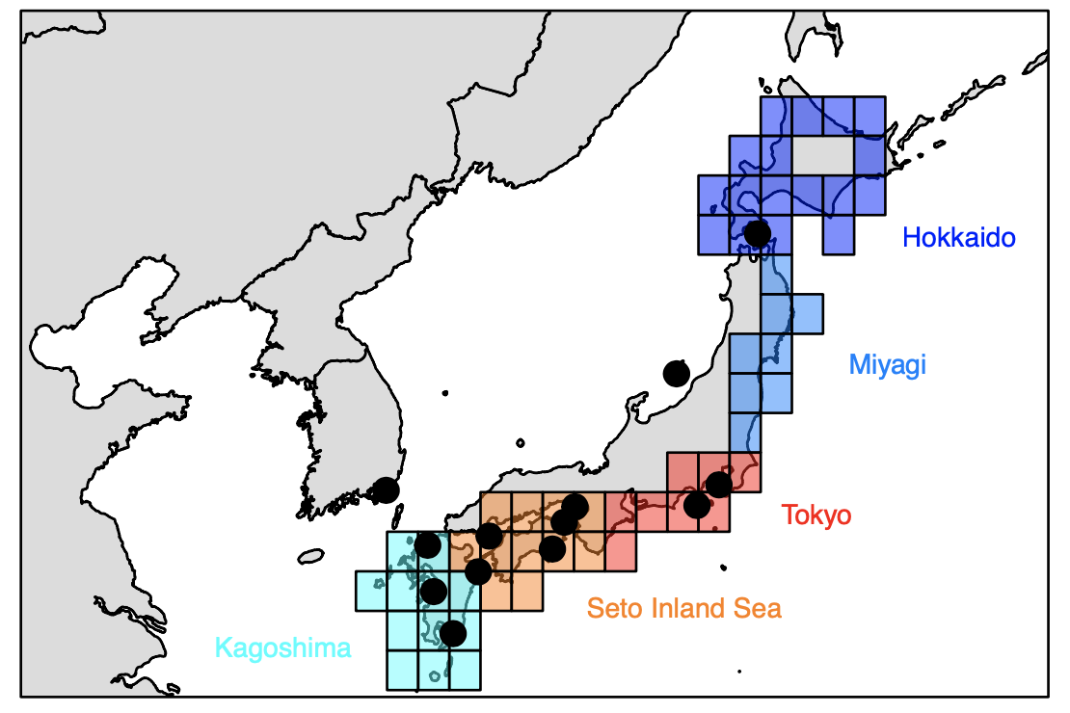
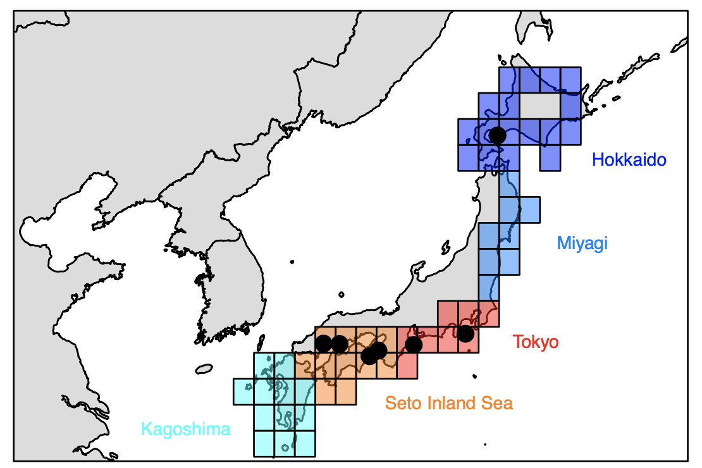
Cases with no Miyagi
Kogishi et al. - 2010 - Cutleria cylindrica
Le Cam et al 2020
Sargassum muticum

